Slide 1

Mary Lin elementary
Notes:
Good Morning/Afternoon! Today we begin the process of planning our school’s budget for FY23. I know we are all here for the same reason and that is ensuring success for all (enter school name) students. This meeting is to provide an overview of the draft budget and for you to give feedback on the draft budget.

Slide 2
Norms
This is a meeting of the GO Team. Only members of the team may participate in the discussion. Any members of the public present are here to quietly observe.
We will follow the agenda as noticed to the public and stay on task.
We invite and welcome contributions of every member and listen to each other.
We will respect all ideas and assume good intentions.

Slide 3

GO Team Budget Development Process
YOUR SCHOOL STRATEGIC PLAN…
is your roadmap and your role.
It is your direction, your priorities, your vision, your present, your future.
Step 1: Data Review
Step 2: Strategic Plan Review
Step 3: Budget Parameters
(Strategic Priorities)
Step 4: Budget Choices
Notes:
Today I will provide an overview of the budget allocations for FY23. We will begin the work of funding the strategic priorities we agreed upon during our strategic review meeting. (IF YOU HAVE NOT DECIDED ON YOUR PRIORITIES, YOU WILL SAY – WE WILL DECIDE ON OUR PRIORITIES AND THEN DISCUSS ALLOCATING FUNDS TO ADDRESS THOSE PRIORITIES).

Slide 4
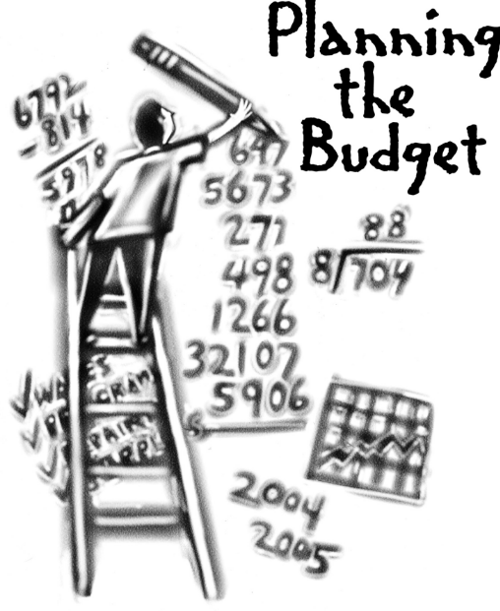
Overview of FY ‘24 GO Team Budget Process
Step 1 Review and Update Strategic Plan and Rank Strategic Priorities
By end of Fall Semester
Step 6 Principals: HR Staffing Conferences Begin
Late February – Early March
Step 3 GO Team Initial Budget Session: Allocation
January 24 – early February
Step 7 GO Team Final Budget Approval Meeting
Budgets Approved by March 17
Step 5
GO Team Feedback Session: Draft Budget Presented & Discussed February – multiple meetings, if necessary
Step 4 Principals: Associate Supt. Discussions and Review
February (supports needed, specific challenges, coaching)
Step 2 Principals: Workshop FY 24 Budget
January 24
GO Teams are encouraged to have ongoing conversations

Slide 5
Budget Allocation Meeting
What
The first GO Team meeting is when the principal will provide an overview of the budget allocation for GO Team members and the general public.
Why
This meeting provides an opportunity for the principal and GO Team to ensure alignment on the school’s key strategic priorities, gain a deeper understanding of the budget allocation, and provide input to drive the direction of the draft budget.
When
End of January- Early February

Slide 6
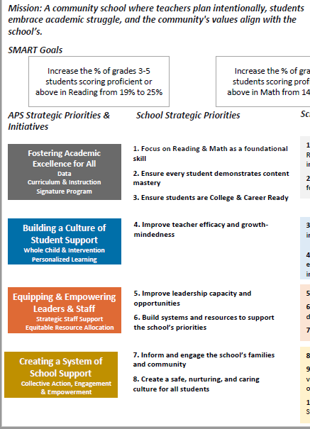
FY24 Budget Development Process
Principal’s Role
Design the budget and propose operational changes that can raise student achievement
Flesh out strategies, implement and manage them at the school level
Focus on the day-to-day operations
Serve as the expert on the school
Hire quality instructional and support personnel
The GO Team’s Role
Focus on the big picture (positions and resources, not people)
Ensure that the budget is aligned to the school’s mission and vision and that resources are allocated to support key strategic priorities

Slide 7
Mission: With a caring culture of equity, trust and collaboration, every Mary Lin Rocket will be promoted to middle school with independence, curiosity, and the desire to achieve.
Mary Lin Elementary School
Vision: We encourage academic achievement in each student. We establish a creative, collaborative, and respectful culture where each student’s social, emotional, and physical well-being is valued.
SMART Goals
Percentage of students in grades 3-5 scoring proficient in ELA will increase by 1% each year through 2025. Currently MLE has 89% proficient ELA.
Percentage of students in grades 3-5 scoring proficient in Math will increase by 2% each year through 2025. Currently MLE has 76% proficient Math.
Show overall growth for at least 75% of the population in both ELA and Math. At least 75% of our kids show 30
Close the achievement gap between all subgroups.
APS Strategic Priorities & Initiatives
School Strategic Priorities
School Strategies
Fostering Academic Excellence for All
Data
Curriculum & Instruction
Signature Program
1. Use data to inform instruction
2. Adhere to the scope and sequence of the Georgia Standard of Excellence and supplement with other resources.
Hold monthly data digs lead by administration.
Weekly lesson planning and internalization lead by instructional coaches.
1. Create collaborative school culture that embraces diverse families that comprise the Mary Lin Community.
2. Build teacher capability to meet the diverse social, emotional, and academic needs of students.
3. Provide unique learning opportunities to cultivate students’ curiosity of learning.
4. Prioritize students’ social and emotional growth as a means to ensuring future success.
Created a new Equity, Diversity, and Inclusion Committee on our PTA.
Provide equity and anti-basis training for all staff members.
Engages students in weekly STEM Activities, Science Fair, Science Night, Spelling Bee, Math Family Night, Inclusive School’s Week, No Place for Hate Week, Red Ribbon Week, Black History Celebration, and Girls on the Run, LEEP after-school activities, and Helen Ruffin Reading Bowl.
Administer BASC to screen for students who need additional support. Implement small group and individual counseling sessions. Dedicate 15 protected minutes for Morning Meeting and Second Step lessons that focus on social and emotional growth.
Building a Culture of Student Support
Whole Child & Intervention
Personalized Learning
Equipping & Empowering Leaders & Staff
Strategic Staff Support
Equitable Resource Allocation
    Our Mary Lin Foundation Grants must be screened and approved.
    Additional Support Staff hired (Nurse, hourly intervention teachers, full-time substitutes,, etc.).
    Provide professional learning opportunities to empowering and equipping teachers to work with our diverse population.
1. Equitably align our school resources with our mission and vision
Creating a System of School Support
Collective Action, Engagement & Empowerment
              1. Provide an environment that retains, empowers, motivates, and inspires teachers to utilize individual strengths
System of accountability for school-based leaders.
Leadership and professional learning opportunities for all staff members based on strengths.

Slide 8
Mary Lin Elementary
Strategic Plan
Priority Ranking
Insert the school’s priorities from Higher to Lower
Higher
Build teacher capability to meet the diverse social, emotional, and academic needs of students.
Provide unique learning opportunities to cultivate students’ curiosity of learning.
Create collaborative school culture that embraces diverse families that comprise the Mary Lin Community.
Lower

Slide 9

FY24 Budget Parameters
FY24 School Priorities | Rationale
Maintain lower class sizes in the primary years by funding parapros in 1st and second grade | 47% mobility rate requires a great deal of teacher attention to students who enter our school throughout the year – many of which are below level.
Maximize wrap around services ie: Nurse, SSW, Counseling | This continues to be a need for our students, but we need to look closely at maximizing our budget to make this work.
Increase Reading/Lexiles and writing of 3rd – 5th grade students. How can we restructure our program to achieve this? | Data indicates that students who have been with us for more than one year have greater performance levels than students who are transient. With 47% of our students coming and going, there is a need to target these students.
Example
Notes:
Review the priorities that the GO Team has developed and the rationale for these priorities. Feel free to copy this slide if you have more than 3 priorities to account for.

Slide 10
FY24 Budget Parameters
FY24 School Priorities | Rationale
Maximize the intervention block daily | Dedicated time for students to receive specific interventions and/or enrichment.
Utilize data to meet the individual needs of students. | Ensure that students are receiving maximized opportunities for achievement and remediation daily
Example
Notes:
Review the priorities that the GO Team has developed and the rationale for these priorities.

Slide 11
Discussion of Budget Summary
(Step 4: Budget Choices)

Slide 12
Executive Summary
This budget represents an investment plan for our school’s students, employees and the community as a whole.
The budget recommendations are tied directly to the school’s strategic vision and direction.
The proposed budget for the general operations of the school are reflected at $5,375,973
This investment plan for FY24 accommodates a student population that is projected to be 540 students, which is a decrease of 115 students from FY23.
Notes:
Here’s a few highlights for our budget this year – read executive summary

Slide 13
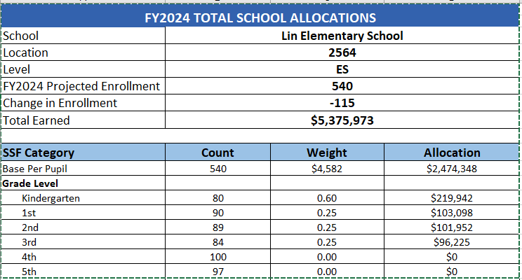
School Allocation
Notes:
For FY23, APS is continuing to increase equity within the District and the flexibility principals have in regards to our schools budgeted funds. The new Student Success Funding Model (SSF) allocates dollars to schools based on the number of enrolled students and receives a funding "weight" based on need. This year, student characteristics were weighted based on:
Grade Level –
K-12
Poverty – Weighted for all Direct Certification enrolled students.
Beginning Performance – Weighted Middle School and High School students entering with beginner’s performance on milestones.
ESOL – Weighted for all ESOL designated students in order to supplement due to ESOL staff being locked.
Special Education - Weighted for all Special Education students.
Gifted – Weighted and measured by number of students in the Gifted Program
Small School Supplement – Weighted for low enrollment schools
ES – 500
MS – 600
HS – 700
As you can see, our projected enrollment for FY23 is _______, we increased/decreased by __________ from last year.
We received the following weights for our student characteristics: (Below is just for the script, principals need to insert their school’s characteristics)
Grade Level
Poverty
Special Education
Gifted
Gifted Supplement
ELL
Small School Supplement

Slide 14
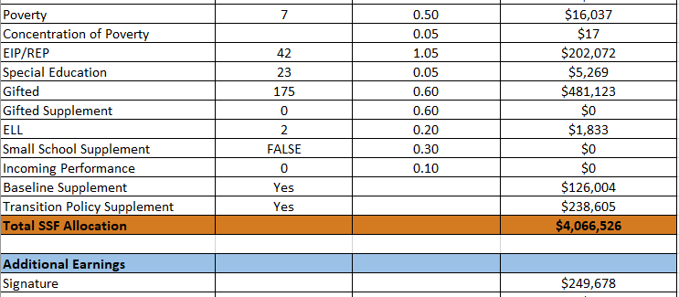
School Allocation
Notes:
Additionally, we received money for signature programming, turnaround, Title I and FTE Allotments.

Slide 15
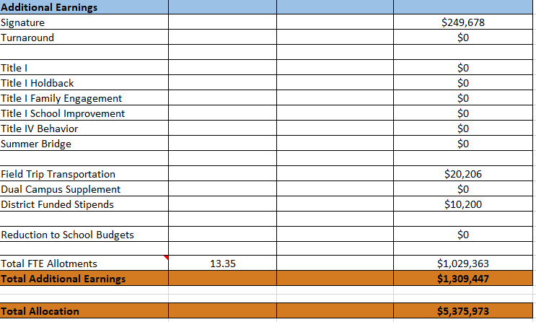

Slide 16
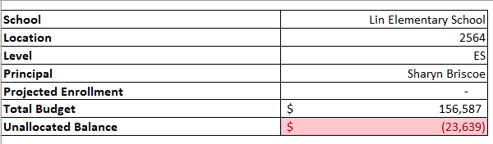
School FY24 CARES Allocation
In addition to a General Fund allocation, our school has been allocated CARES funding that must be used to support implementation of the school-based intervention block and other school-based needs as a result of the COVID-19 Pandemic.
Once the support needed to implement our school-based intervention block/course has been fulfilled, we can use the remaining CARES funds to address other school-based needs that are a result of the COVID-19 Pandemic.
Notes:
Please add your school’s CARES Allocation to this slide.

Slide 17
CARES Allocations
Other allowable CARES expenditures include:
Technology Support: Software, assistive technology, online learning platforms, subscriptions.
Mental and Physical Health: Cover the costs of additional counseling, telehealth, therapeutic services, and wraparound services and supports (contracted hours, professional learning, programs)
Supplemental Learning: Cover costs of remediation, and/or enrichment opportunities during the school year for students (afterschool programs, additional pay for teachers and staff, transportation).
Professional Development: Cover costs of additional professional development for school leaders, teachers, and staff (trainings, extended professional development days, consultants, programs).
At-risk Student Populations: Cover costs of school specific activities, services, supports, programs, and/or targeted interventions directly addressing the needs of low-income students, SWD, racial & ethnic minorities, ELL, migrant & homeless students, and students in foster care.
Continuity of Core Staff and Services. Restore any potential LEA FY22 budget reductions due to decreased state and/or local revenue.

Slide 18
What’s Next?
January
  GO Team Budget Allocation Meeting (Jan. 24th-early February)
February
  One-on-one Associate Superintendent discussions
  Cluster Planning Session (positions sharing, cluster alignment, etc.)
  Program Manager discussions and approvals
  GO Team Feedback Meeting(s) before principal’s staffing conference
  HR Staffing Conferences (Late February)
March
  Final GO Team Approval Meeting (AFTER your school’s Staffing Conference and BEFORE Friday, March 17th)
Notes:
In February, we will meet again to discuss how the school’s budget has been allocated to support the programmatic needs and FY23 key strategic priorities.
If think we need to continue our budget conversations, we will schedule additional meetings. My goal is to make sure your voices are reflected in our school’s budget.
I will also be meeting with my Associate Superintendent, program managers and other key leaders to go over our budget and to make sure the school is meeting the standards of service and appropriately staffing.
During the week of Feb. 24th -March 2nd , HR Staffing Conferences will be held. At this meeting, I will present my plan for staff utilization, resource distribution and plan for staffing implications.
We will need to approve the budget at the ________ meeting.

Slide 19

Questions?
Thank you for your time and attention.
Notes:
IF YOU FEEL YOUR TEAM IS READY TO APPROVE THE DRAFT BUDGET, PLEASE DO SO. PLEASE REMIND THEM THAT YOU MAY NEED TO MEET WITH THEM AGAIN, IF THERE ARE CHANGES FROM YOUR MEETINGS WITH DISTRICT LEADERSHIP. LET THEM KNOW YOU WILL KEEP THEM INFORMED!!

